Slide 1

Data Science to Empower Clinical Trial
27Mar2026 Haitao Xu
V:2024.09_V0

Slide 2
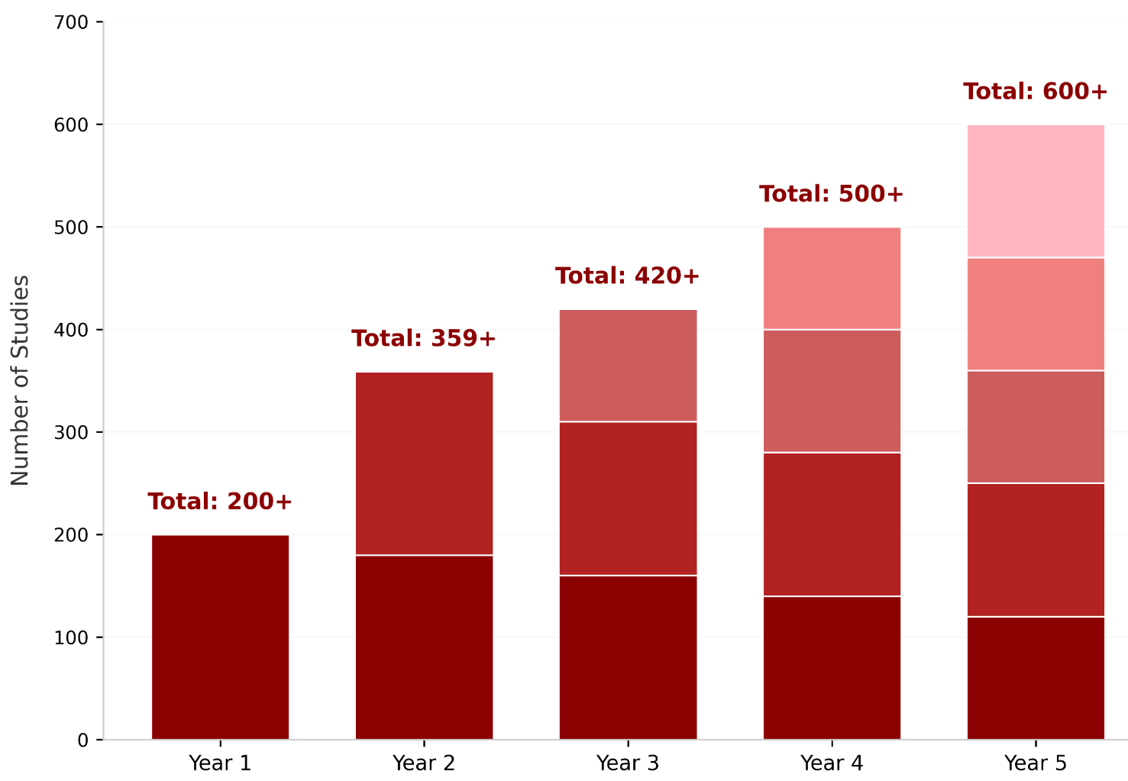
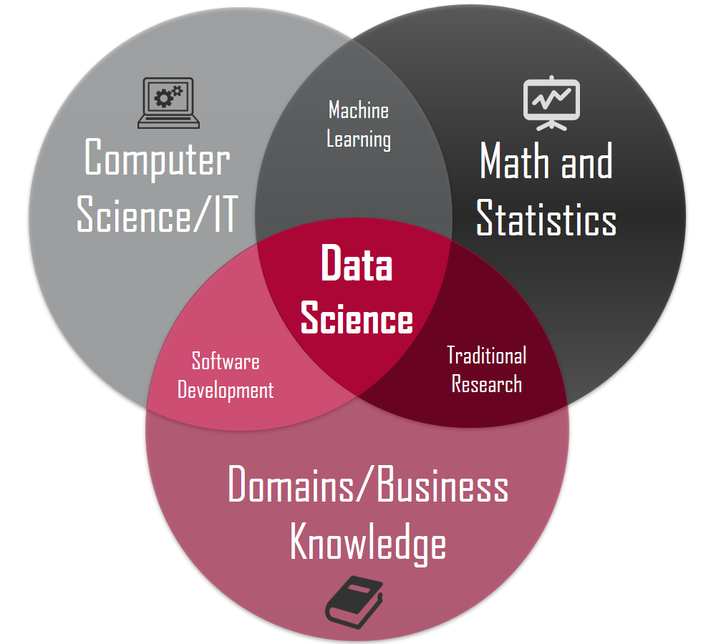
Data Science, WHY & HOW
Data-Driven Growth: Addressing Critical Gaps in Clinical Trial Management
• Automation for Efficiency • Proactive Oversight • Integrated Decision-Making
Clinical Data Science – Integration of
Advanced Data Analysis
Platform Infrastructure
Clinical Domain Knowledge
Confidential

Slide 3




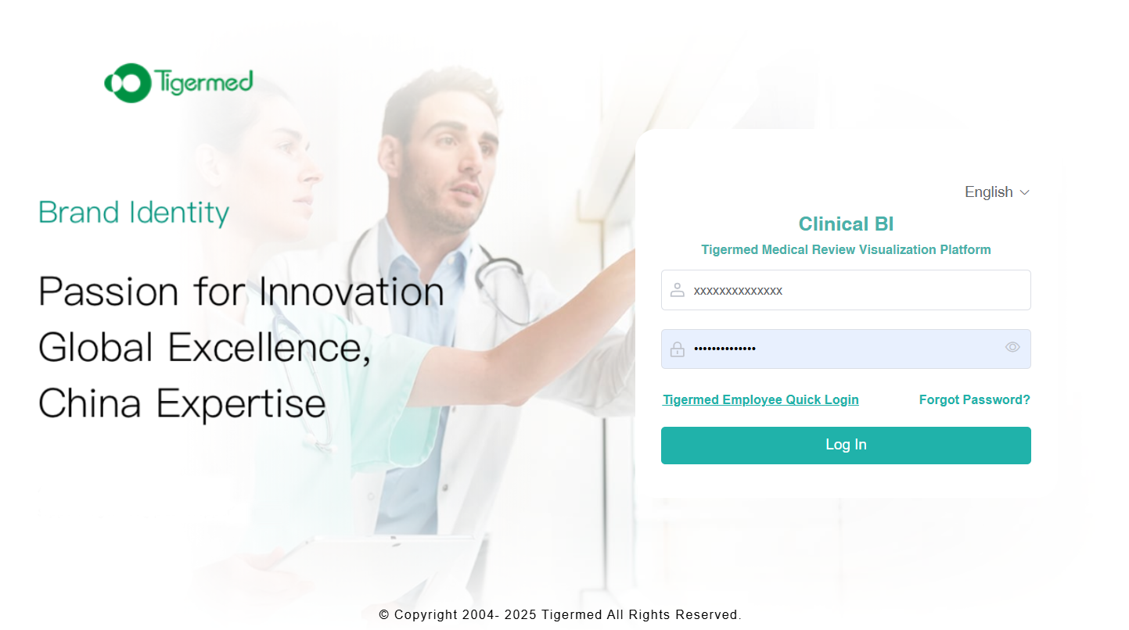
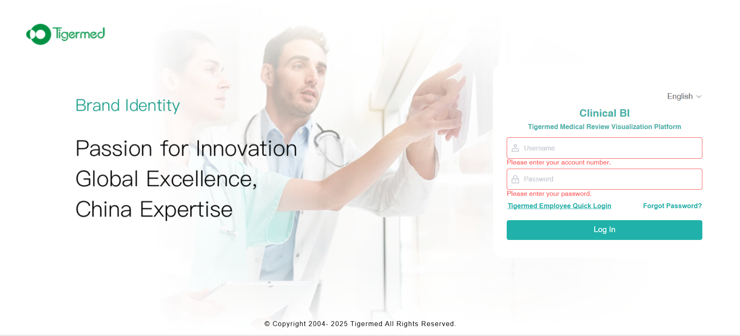


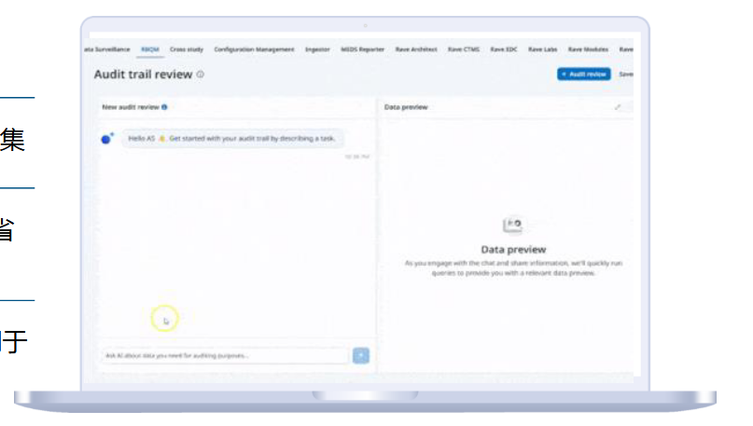

Clinical Data Visualization
Drive Timely, Clear, and Efficient Research with T+1 Updates.
Real-time & Multi-dimensional
Improve Review Efficiency and Decision Quality
Proactive Risk Control
Study Team
Project Intelligence
Medical Insights
Medical Monitoring
More…
Raw
Data
Daily Automatic
Transmission
Tigermed Self-developed Clinical Data Visualization Platform
Tigermed Data Science (Study) Team
Visualization Solution Design
Data Processing & Dashboard Generation
Ongoing Operation & Maintenance
Confidential

Slide 4
General Process
Project Intelligence
Medical Insights
Data Aggregation
Data Processing
Data Visualization
Medical Monitoring
More…
Confidential

Slide 5
The Clinical Data Science Trifecta: SAS, R & Python
Dimension | SAS | R | Python
🔄 Clinical Data Processing​ | • The Compliance Anchor​ - Gold standard for regulatory submission (FDA/EMA). - Built-in, validated CDISC (SDTM/ADaM) workflows. | • The Statistical Innovator​ - Rich ecosystem for novel & complex analyses. - Empowers​ statisticians beyond traditional reporting. | • The Automation Engine​ - Excels at data wrangling & pipeline automation. - Lacks native regulatory framework.
📈 Learning Curve​ | • Enterprise-Standard​ - Dedicated syntax, but structured. - Mature corporate training paths. | • Statistician-Native​ - Low barrier for statistical thinking. - High ceiling for advanced programming. | • Generalist-Friendly​ - Intuitive syntax, vast beginner resources. - Easy path to software engineering practices.
🖥️ Platform Integration​ | • Evolving (Viya)​ - Traditionally closed; modern cloud APIs improving. | • Agile but DIY​ - Great for APIs & prototypes (e.g., plumber, Shiny). - Your key to building agile tools.​ | • Integration Leader​ - Designed for modern stacks (Web, Cloud, Spark). - De facto standard for production systems.
🤖 AI / ML Ecosystem​ | • Validated & Stable​ - Trusted, production-ready algorithms. - Slow on cutting-edge AI adoption. | • Statistical ML Powerhouse​ - Your domain:​ Best-in-class modeling (tidymodels). - Deep learning growing (torch), but not dominant. | • The AI Behemoth​ - Dominant in deep learning (TF, PyTorch) & broad ML. - Unmatched community momentum.

Slide 6
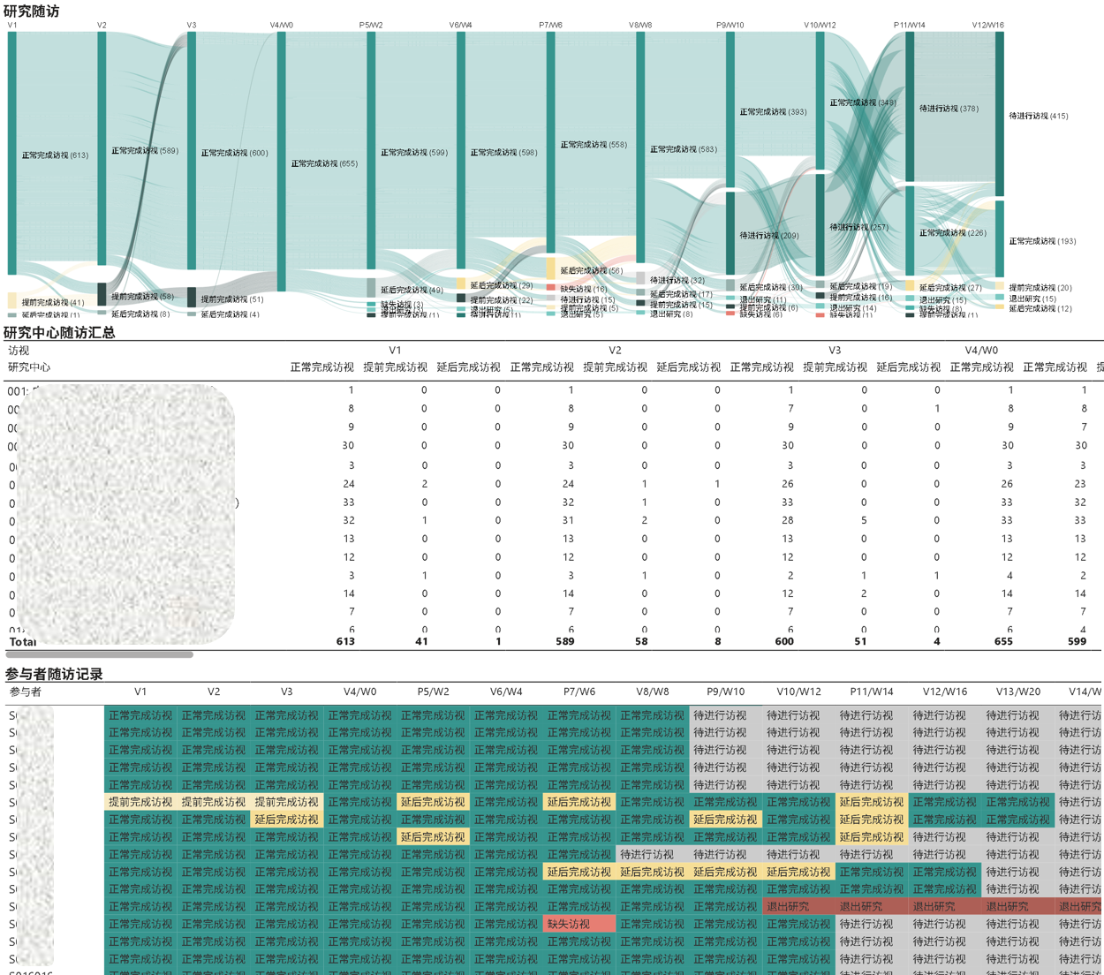
Project Intelligence
Confidential
Demo: Participant Visits

Slide 7
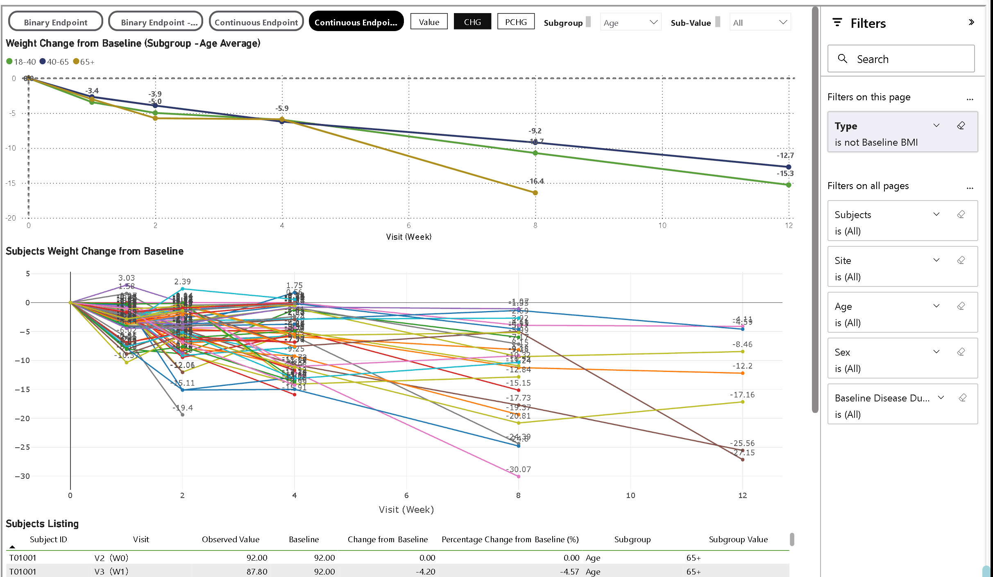
Medical Insights Visualization
Empowering Deeper Signal Detection and Risk-Benefit Decisions
Medical Insights：
Unexpected Patterns or Trends;
Consistency Across Regions/Sites;
Efficacy Evaluation and Interpretation；
Interpretation of Subgroup Analysis Results;
And so on..
The primary and secondary endpoints will be analyzed as both continuous variables (observed value, change from baseline, percentage change from baseline) and binary categorical variables (responder rates), with summaries presented for all study visits.
Population Filters：
Region;
Site;
Subgroups;
Participant;
Demo
7
Confidential
Confidential

Slide 8
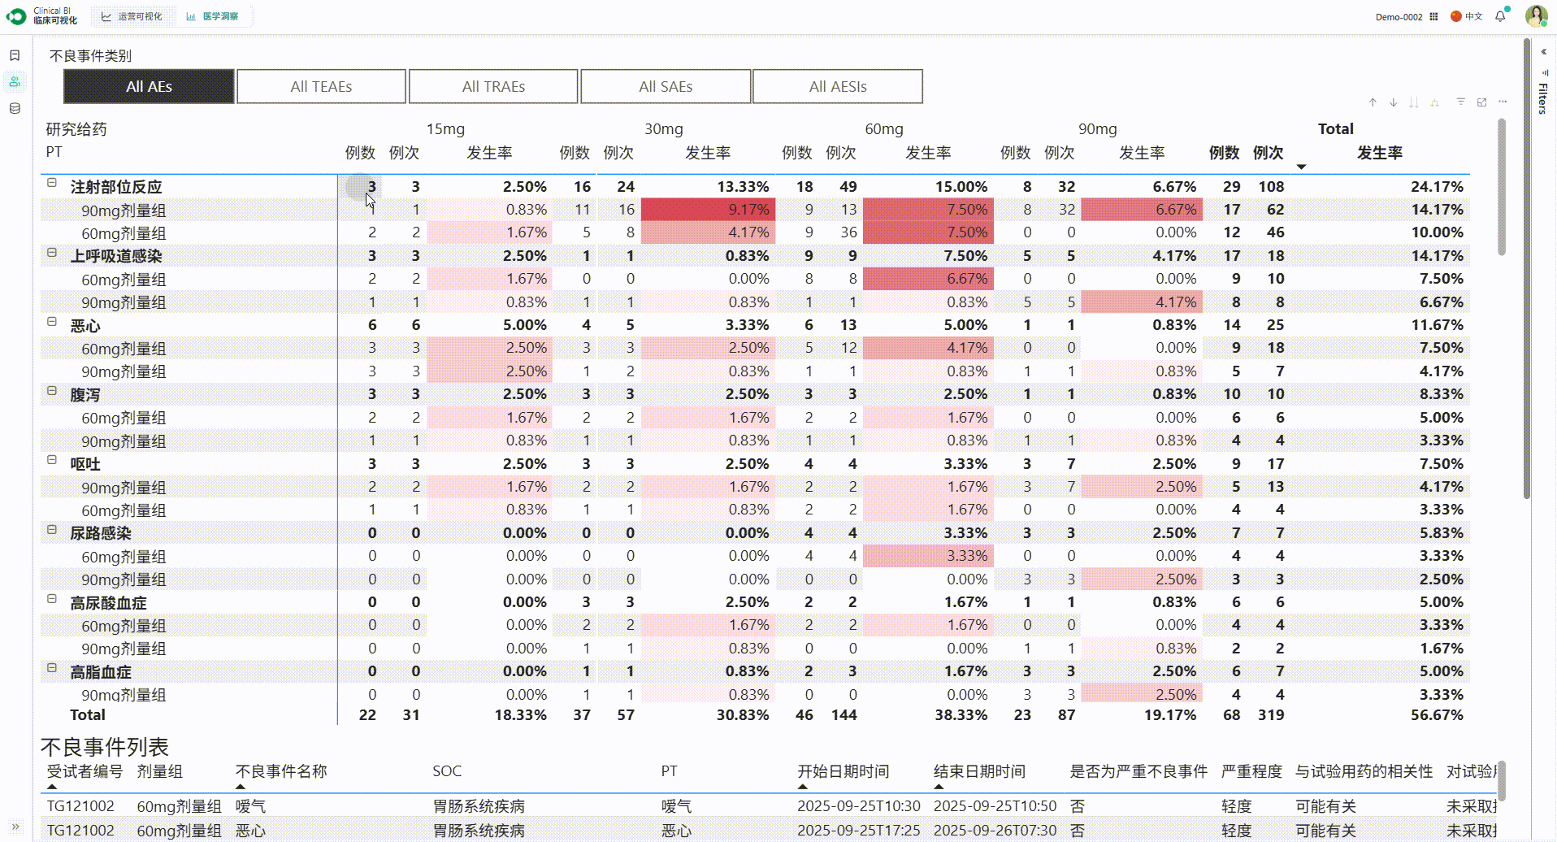
One Visual, Clear Insight
3.参与档案
AE Incidence: Highlighting Dose-Related and Temporal Trends
This chart provides a clear, multi-dimensional view of adverse event (AE) incidence. The horizontal axis organizes data by dose groups (15mg, 30mg, 60mg, 90mg, and Total) and further segments it into specific time intervals. The visual layout, with red highlighting for high-incidence items, allows for the immediate identification of safety signals and dose-dependent trends, facilitating rapid clinical assessment.
Demo
Confidential

Slide 9
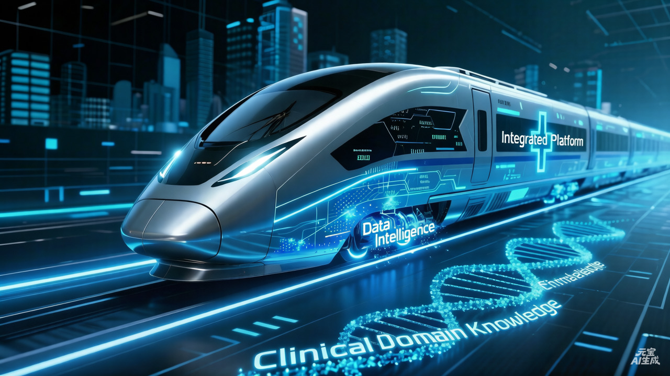
Confidential

Slide 10



服务创新 共筑健康
全球总部：中国浙江省杭州市滨江区聚工路19号，盛大科技园A座18楼，310051
国际总部：中国香港炮台山北角电气道218号，港汇东12楼1201室
客户服务中心
邮箱: clientservice@tigermedgrp.com
电话: 400 070 7751
泰格医药集团
www.tigermedgrp.com

